Slide 2
Elections and Voter Outreach Laws for Postsecondary Institutions
-------------

Slide 3
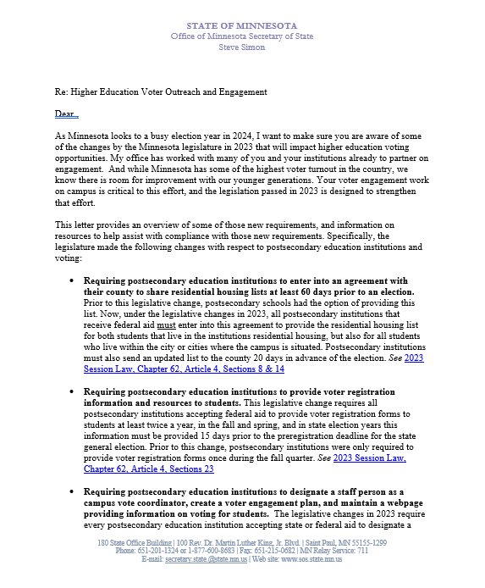
Letter From Secretary Simon Sent Fall 2023

Slide 4
1 2 3 4 5 6 7
Elections Items That Minnesota Law Says Colleges and Universities Must Do

Slide 5
1 2 3 4 5 6 7
Please.

Slide 6
1 2 3 4 5 6 7 8
Written agreement to County Auditor
To provide student housing lists for each election
By 60 days before the first election of the year.
Lasts for the calendar year

Slide 7
1 2 3 4 5 6 7 8
Prepare current list of enrolled students
Living in campus housing
Living in the campus city/cities (state aid)
-MAY include up to 10 miles from campus (federal aid)
Certified (signed off as current and accurate)
To Auditor each election (not before 20 days prior)

Slide 8
1 2 3 4 5 6 7 8
Provide registration forms to each student
Spring of each year
Fall of each year
Even years: delivered at least 36 days before the state general (November) election.
If form is provided electronically, email or text must be exclusively about voter registration.

Slide 9
1 2 3 4 5 6 7 8
Consult with campus student government
Most effective means of:
Distributing forms
Facilitating election day registration of students
To create voter engagement plan/report (#7)

Slide 10
1 2 3 4 5 6 7 8
Web page of voter/elections information
Voter registration and voting requirements
Deadlines
Residency requirements/methods to prove
Voting options
Resources for students registered in other states
Campus vote coordinator name/contact (see #6)
Voter engagement plan/report (see #7)

Slide 11
1 2 3 4 5 6 7 8
Designate staff Campus Vote Coordinator
Ensure institution complies requirements
Consult with campus student government (see #4)

Slide 12
1 2 3 4 5 6 7 8
Submit annual campus voter engagement report/plan by November 30
Outline efforts to implement these items
How and when registration forms were distributed
Campus voter engagement plan

Slide 13
1 2 3 4 5 6 7 (8)
The County Auditor shall notify all postsecondary educational institutions about these requirements.

Slide 14
Find all of these and the statutes behind them here:
https://www.sos.state.mn.us/elections-voting/get-involved/postsecondary-elections-resources/
Michael Wall, Youth Voter Outreach Specialist
Michael.Wall@state.mn.us 651-201-6892

